Slide 1
TOPIC B1:
PROBLEM SPECIFICATION
LESSON B1-1
PROBLEM SPECIFICATION

Slide 2
AGENDA
Problem Specification
Problem Statement
Constraints & Limitations
Goals & Objectives
Input & Output
Evaluation Criteria
Stakeholders
NOTE!
Have a way to take notes and a way to write code available for this lesson

Slide 3

THE WARM UP QUESTION
Write a recursive function to calculate the result of input values a and b when exponentiated as (a^{b})

Slide 4
THE WARM UP ANSWER
Write a recursive function to calculate the result of input values a and b when exponentiated as (a^{b})

Slide 5
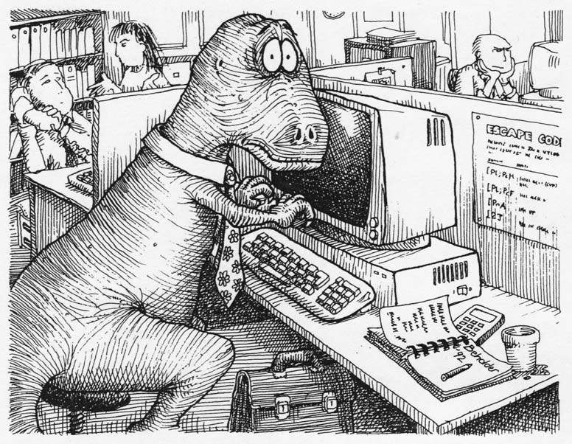
PROBLEM SPECIFICATION
Since the dawn of time, computers have needed instructions
How do we provide these instructions to computers in the modern day?

Slide 6
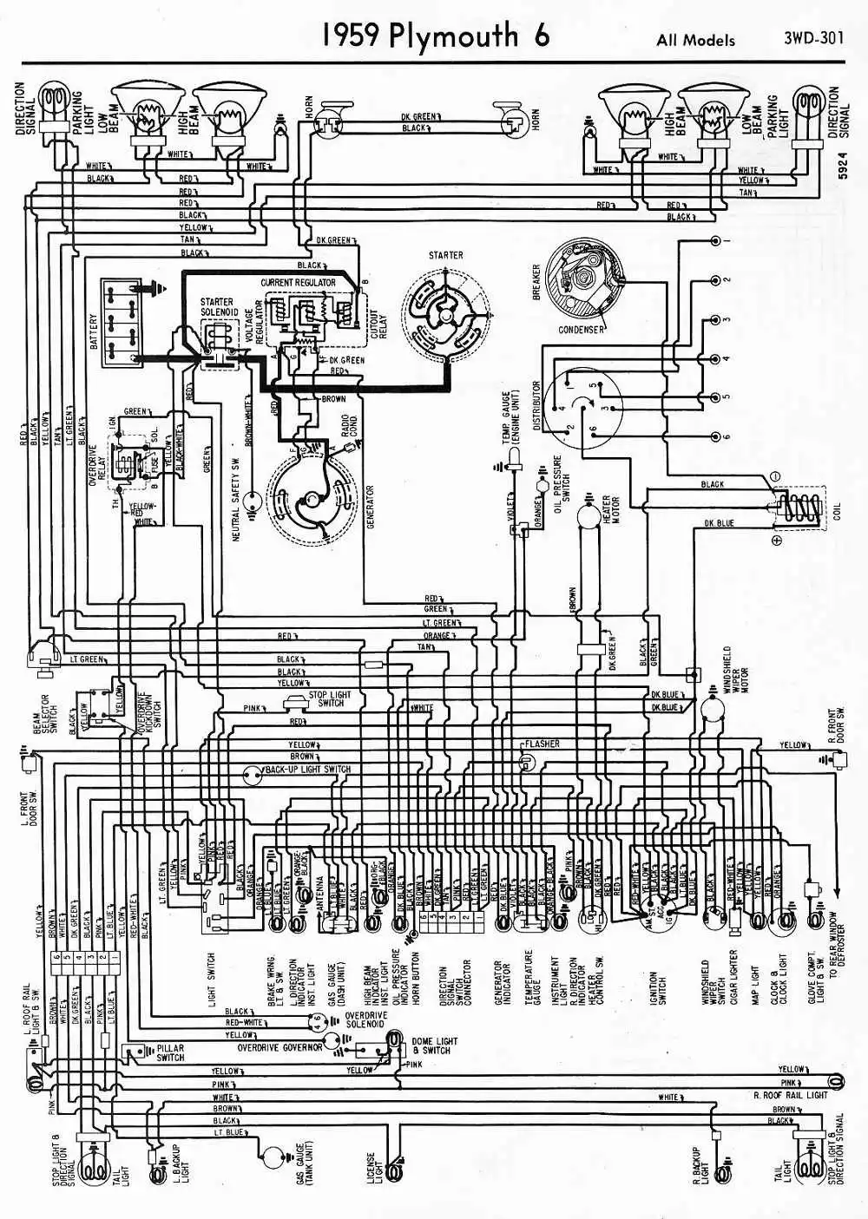
PROBLEM SPECIFICATION
Programming languages are our tool of choice in the modern age
Before we had modern computers, programming languages were developed as a series of steps to physically wire a particular program into a computer

Slide 7
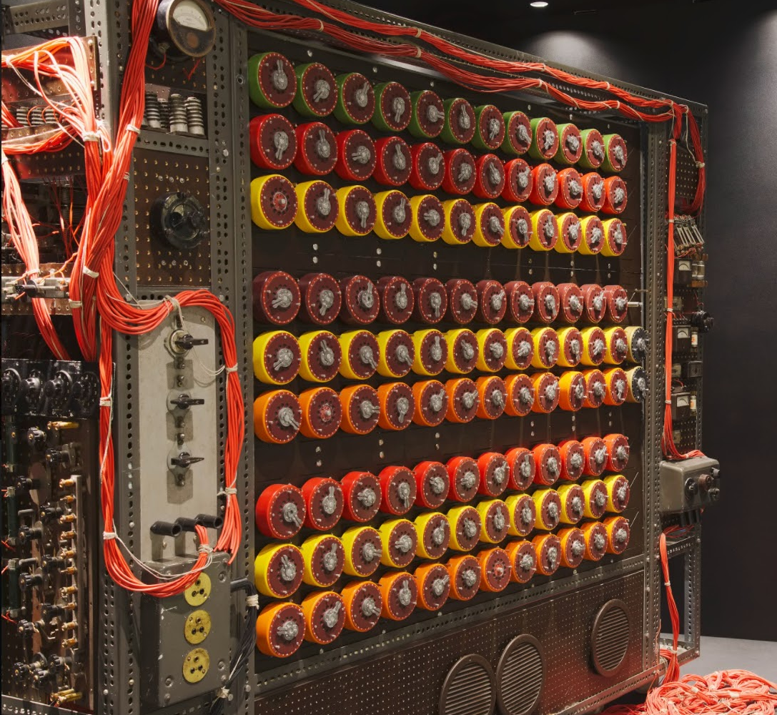
PROBLEM SPECIFICATION
Like we saw during The Imitation Game film from last year, these computers looked nothing like our modern computers
These computers had no functionality to do things like iteration (loops), conditionals (if statements), and certainly no Object-oriented programming

Slide 8
PROBLEM SPECIFICATION
However, even with all of the differences programming used to have, there’s one thing that’s always been true
Creating a program is done to solve a problem
But you can’t solve a problem before you understand it inside and out

Slide 9

PROBLEM SPECIFICATION
A problem specification is a short, clear explanation of an issue
It outlines who the stakeholders are
It may include:
Problem Statement
Constraints & Limitations
Objectives & Goals
Input & Output Specifics
Evaluation Criteria

Slide 10
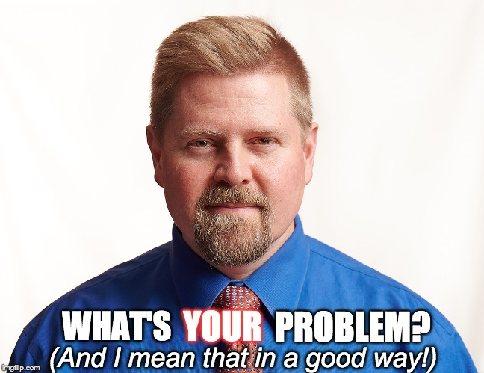
PROBLEM STATEMENT
A good problem statement should include the following:
A description of the problem itself
Identifying who the solution is for
Identifying what of the problem needs to be solved
To aid in your understanding of the problem, you often need context
Research, personal experience, discuss with stakeholders

Slide 11
PROBLEM STATEMENT
Students often forget homework deadlines
What’s the problem?
Who is the solution designed for?
Why is the problem a problem?
Write the answers to these questions, and we’ll share how we interpret this single statement

Slide 12
PROBLEM STATEMENT
Now do this: A student with dyslexia struggles with reading long passages
What’s the problem?
Who is the solution designed for?
Why is the problem a problem?
Write the answers to these questions, and we’ll share how we interpret this single statement

Slide 13
CONSTRAINTS & LIMITATIONS
Now, with our problem clearly defined, let’s identify some possible constraints & limtations
Common examples include
Tech (hardware/software requirements)
Money (“Economic aspect”)
Legislation (Regulations as well as social, ethical things)
Staffing/Hands on deck (Operational issues)
Schedule/Time

Slide 14
CONSTRAINTS & LIMITATIONS
Working off of YOUR problem statement, what might the limitations be for the “Students often forget homework deadlines” problem?

Slide 15
CONSTRAINTS & LIMITATIONS
Working off of YOUR problem statement, what might the limitations be for the “A student with dyslexia struggles with reading long passages” problem?

Slide 16
GOALS & OBJECTIVES
Now that we have our limitations, let’s explicitly outline the goals of our solution
If I have the “students often forget homework deadlines” problem, maybe my goals look like this:
Students are able to view every currently assigned homework due date at the same time
Students are able to view these due dates at any time or place
The information is digestible and clear
Responsibility and timeliness is encouraged in students

Slide 17
GOALS & OBJECTIVES
Now, to meet these requirements, there’s a lot that can be done
It could be as complex as a website like ManageBac that centrally locates all of the information about assignments that they can log into from anywhere
It could be as simple as literally giving each student a special schedule planner and a little bit of time in class to note down each homework as it’s assigned
(although this obviously likely wouldn’t be given to the tech department lol)

Slide 18
GOALS & OBJECTIVES
What might the goals & objectives of the dyslexia problem’s solution be?

Slide 19
INPUT & OUTPUT
Assuming that we are using a website for reminding students of their homework due dates…
We can assume the inputs for this system would be the homework assignment information
Date, name, class, attatchments, etc.
We can assume that the outputs for the system would be the information as displayed to students
A list of (likely sorted), categorized, assignments and their due dates

Slide 20
INPUT & OUTPUT
We could even take this further by making a mock-up of what we would like the output to look like

Slide 21
INPUT & OUTPUT
What might our inputs and outputs look like for the dyslexia system?
Use your previous ideas to create this

Slide 22
EVALUATION CRITERIA
We’ll need some success criteria to evaluate our problem’s solution on
You’ve probably had experience with writing success criteria for your MYP personal project
You’ll have even more experience with this during your IA in this class

Slide 23
EVALUATION CRITERIA
For the homework problem, our success criteria may look like this (we may want to base these on our goals from previous):
Technical Goals:
Students must be able to check deadlines easily
Students should receive automatic reminders (email, text)
Deadlines should be able to be added using 3-4 clicks
Deadlines should be viewable using 3-4 clicks
Deadlines must always match teacher input (no errors)
Impact Goals:
>70% report finding the system helpful to keep track of deadlines
>50% reduction in missed homework deadlines in students using system
>80% of students use the system weekly

Slide 24
EVALUATION CRITERIA
Now try to make success criteria for the dyslexia system
It can be hard to use specific numbers without data ahead of time, so you can make these numbers up for our purposes

Slide 25
GREATEST COMMON DIVISOR
The Python code to accomplish this is on the right
The base case is if b = 0, meaning that we have found the gcd
Let’s work through the example of 36 and 15
def gcd(a, b): if b == 0: return a else: return gcd(b, a % b) print(gcd(36, 15))

Slide 26
WORK WORK WORK WORK WORKSHEET
You can find WS B1-1 on Github! Have fun!

Slide 27

VOCAB TO REMEMBER
Problem Specification
Problem Statement
Constraints & Limitations
Goals & Objectives
Input & Output
Evaluation Criteria
Stakeholders

